Slide 1
Angular Dashboard Project
Azanae Bond-Brooks

Slide 2

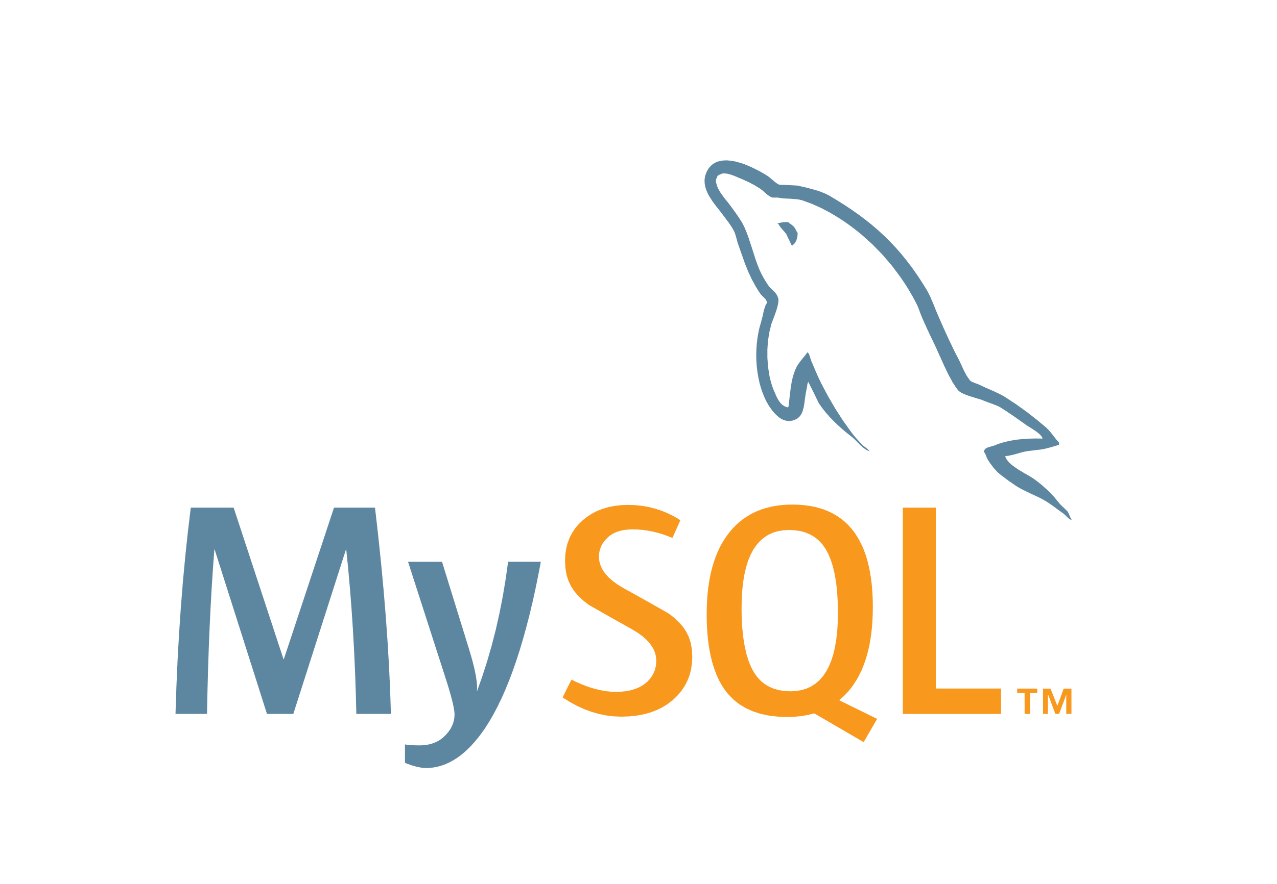

Scenario (Product Dashboard)
REST API ( CRUD Operations) in Spring
Add, update, and retrieve product information
Hibernate (ORM)
Interact with a SQL database
Angular
Utilized on the front-end
MVP Architecture

Slide 3
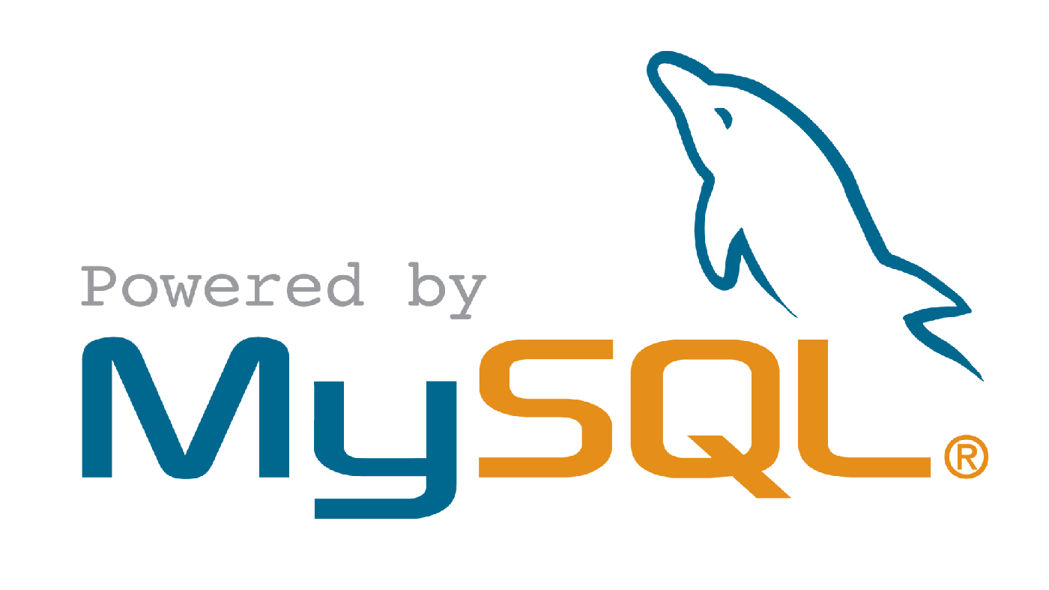

Build SQL Database
Remote MySQL → Hostinger
Tables/Columns
Products (id (PRIMARY) , productName , category , fullPrice …)
Categories (id , categoryName)
Suppliers (id , supplierName)
Tool Used
DataGrip

Slide 4
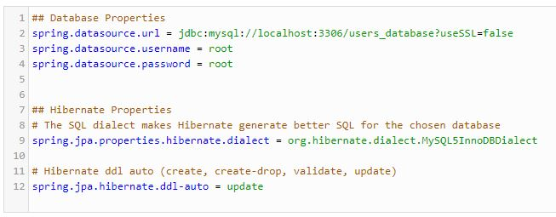
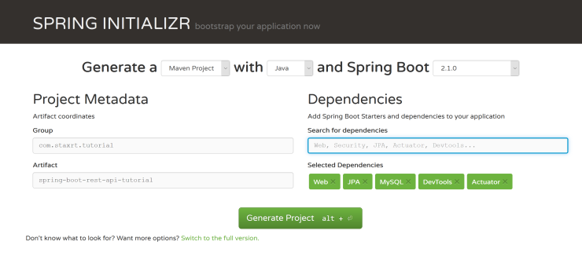
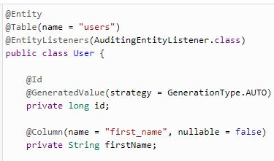
Create REST API with Spring Boot
2. Define Database Configurations
1. Create the Spring Boot Project.
Web — Full-stack web development with Tomcat and Spring MVC
DevTools — Spring Boot Development Tools
JPA — Java Persistence API including spring-data-JPA, spring-orm, and Hibernate
MySQL — MySQL JDBC driver
3. Create Entity Class

Slide 5

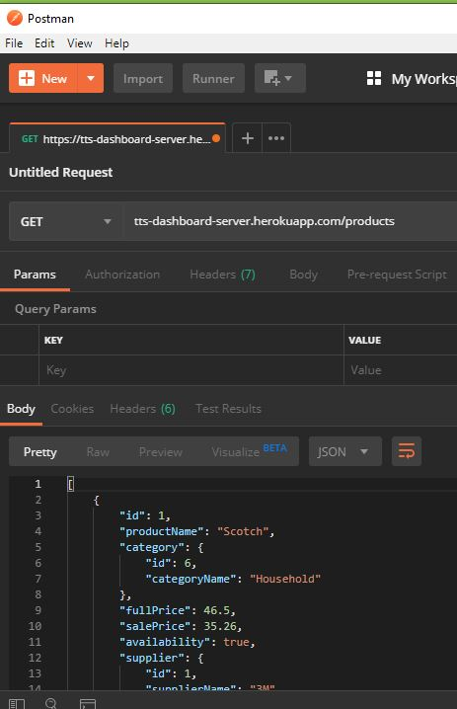
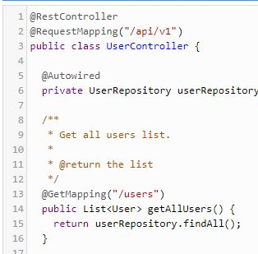
Create REST API with Spring Boot (Cont.)
4. Create JPA Data Repository Layer
6. Test API in Postman.
Deployed to Heroku for Remote Access
5. Create Rest Controllers and Map API Requests

Slide 6
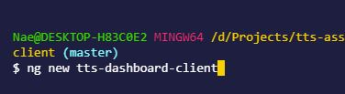

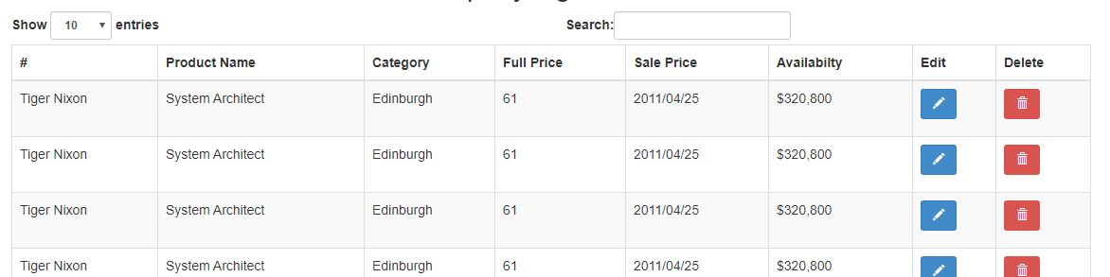

Build Front-End using Angular
1. Create a new project
2. Add Project Components
4. Create Dashboard UI
5. Add Functionality
Sort / Paginator
CRUD functions
Return:
Category
Supplier
Availability
6. Test

Slide 7
Resource / Tools

